Slide 1


Signals & Systems for Computer Engineering
Prof.Dr. B.Berk ÜSTÜNDAĞ
Istanbul Technical University
Faculty of Computer Engineering and Informatics
BLG354E / CRN: 21615
6th Week Lecture (cont.)
2020
bustundag@itu.edu.tr
BLG354E / CRN: 21560
5th Week Lecture

Slide 2
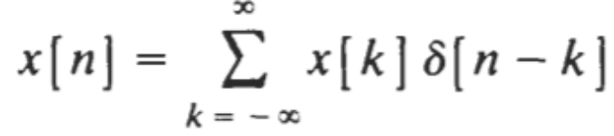





Response of DT LTI Systems to an Arbitrary Input:
Since the system is linear, the response y[n] of the system to an arbitrary input x[n] can be expressed as
Since the system is time-invariant,
Therefore a discrete-time LTI system is completely characterized by its impulse response h[n]
(Lecture Book1: Schaum Outline Series, Signals and Systems)
BLG354E - İTÜ Faculty of Computer Engineering and Informatics - Üstündağ

Slide 3
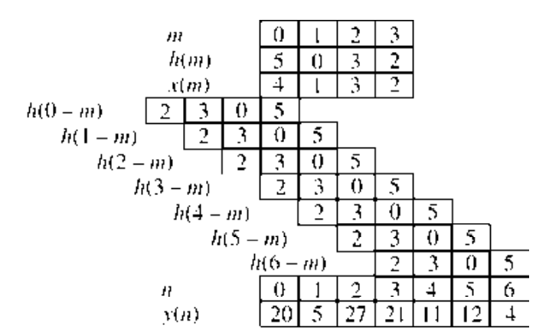
Example:
Impulse response of an LTI DT system is given as h[m]={5, 0, 3, 2}
Find its output pattern if the signal x[m]={4, 1, 3, 2} is applied as the input.
Output: y[m]=x[m]*h[m]
h(0-m)={2, 3, 0, 5} for m=3, 2, 1, 0
BLG354E - İTÜ Faculty of Computer Engineering and Informatics - Üstündağ

Slide 4

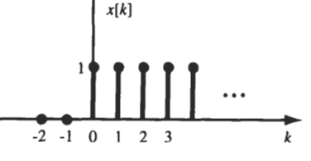



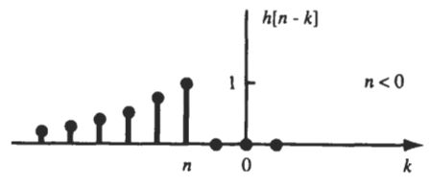

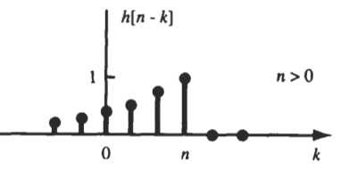
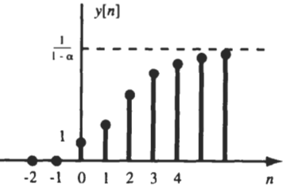

Example:
The input x[n] and the impulse response h[n] of a discrete-time LTI system are given by
BLG354E - İTÜ Faculty of Computer Engineering and Informatics - Üstündağ

Slide 5
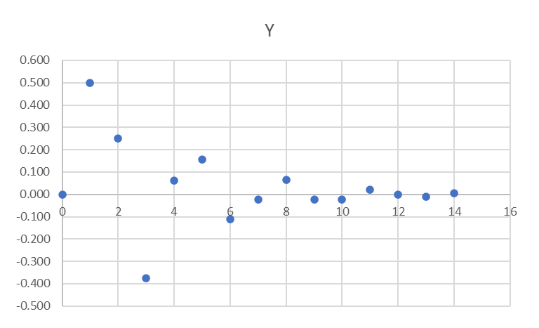
Example:
x[n]
+
E
z⁻¹
A
z⁻¹
B
+
y[n]
∑
1/2
∑
-
+
1/2
a) Find the impulse response of the system via simulation
b) Find the system response for x[n]=n(u[n]-u[n-3]) by simulation
c) Find the system response for x[n]=n(u[n]-u[n-3]) by convolution for the first 5 values
d) Find the impulse response through analytical solution of the transfer function
Psuedo Code:
Y=0.5A+0.5B
E=X-Y
B=A
A=E
n | X | A | B | E | Y
0 | 1 | 0.000 | 0.000 | 1.000 | 0.000
1 | 0 | 1.000 | 0.000 | -0.500 | 0.500
2 | 0 | -0.500 | 1.000 | -0.250 | 0.250
3 | 0 | -0.250 | -0.500 | 0.375 | -0.375
4 | 0 | 0.375 | -0.250 | -0.063 | 0.063
5 | 0 | -0.063 | 0.375 | -0.156 | 0.156
6 | 0 | -0.156 | -0.063 | 0.109 | -0.109
7 | 0 | 0.109 | -0.156 | 0.023 | -0.023
8 | 0 | 0.023 | 0.109 | -0.066 | 0.066
9 | 0 | -0.066 | 0.023 | 0.021 | -0.021
10 | 0 | 0.021 | -0.066 | 0.022 | -0.022
11 | 0 | 0.022 | 0.021 | -0.022 | 0.022
12 | 0 | -0.022 | 0.022 | 0.000 | 0.000
13 | 0 | 0.000 | -0.022 | 0.011 | -0.011
14 | 0 | 0.011 | 0.000 | -0.005 | 0.005
BLG354E - İTÜ Faculty of Computer Engineering and Informatics - Üstündağ

Slide 6
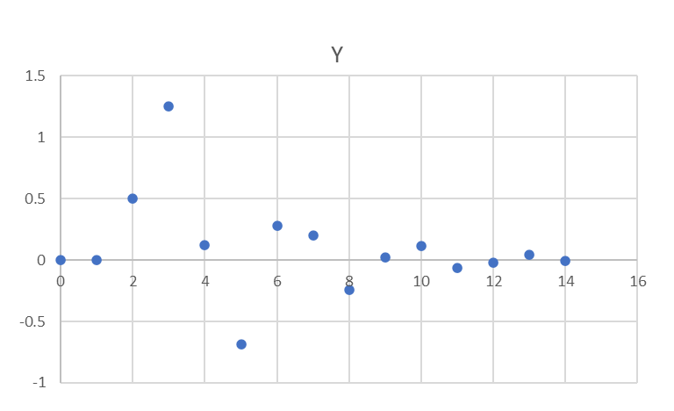
b)
x[n]=n(u[n]-u[n-3]) = {0, 1, 2}
n | X | A | B | E | Y
0 | 0 | 0.000 | 0.000 | 0.000 | 0.000
1 | 1 | 0.000 | 0.000 | 1.000 | 0.000
2 | 2 | 1.000 | 0.000 | 1.500 | 0.500
3 | 0 | 1.500 | 1.000 | -1.250 | 1.250
4 | 0 | -1.250 | 1.500 | -0.125 | 0.125
5 | 0 | -0.125 | -1.250 | 0.688 | -0.688
6 | 0 | 0.688 | -0.125 | -0.281 | 0.281
7 | 0 | -0.281 | 0.688 | -0.203 | 0.203
8 | 0 | -0.203 | -0.281 | 0.242 | -0.242
9 | 0 | 0.242 | -0.203 | -0.020 | 0.020
10 | 0 | -0.020 | 0.242 | -0.111 | 0.111
11 | 0 | -0.111 | -0.020 | 0.065 | -0.065
12 | 0 | 0.065 | -0.111 | 0.023 | -0.023
13 | 0 | 0.023 | 0.065 | -0.044 | 0.044
14 | 0 | -0.044 | 0.023 | 0.011 | -0.011
c)
h[n]={0, 0.5, 0.25, -0.375, 0.063, 0.156}
h[-n]={0.156, 0.0625, -0.375, 0.25, 0.5, 0}
Y=X*h
 |  |  |  |  |  | x0 | x1 | x2
 |  |  |  |  |  | 0 | 1 | 2
8 |  |  |  |  |  |  |  |  | 0.15625 | 0.0625 | -0.375 | 0.25 | 0.5 | 0
7 |  |  |  |  |  |  |  | 0.15625 | 0.0625 | -0.375 | 0.25 | 0.5 | 0
6 |  |  |  |  |  |  | 0.15625 | 0.0625 | -0.375 | 0.25 | 0.5 | 0
5 |  |  |  |  |  | 0.15625 | 0.0625 | -0.375 | 0.25 | 0.5 | 0
4 |  |  |  |  | 0.15625 | 0.0625 | -0.375 | 0.25 | 0.5 | 0
3 |  |  |  | 0.15625 | 0.0625 | -0.375 | 0.25 | 0.5 | 0
2 |  |  | 0.15625 | 0.0625 | -0.375 | 0.25 | 0.5 | 0
1 |  | 0.15625 | 0.0625 | -0.375 | 0.25 | 0.5 | 0
0 | 0.15625 | 0.0625 | -0.375 | 0.25 | 0.5 | 0
 | 0 | 0 | 0.5 | 1.25 | 0.125 | -0.6875 | 0.28125 | 0.3125
 | y0 | y1 | y2 | y3 | y4 | y5
y[n]={0, 0, 0.5, 1.25, 0.125, -0.6875, …}
BLG354E - İTÜ Faculty of Computer Engineering and Informatics - Üstündağ

Slide 7






Convolution of periodic DT signals:
If x₁[n] and x₂[n] are both periodic sequences with common period N, the convolution of x₁[n] and x₂[n] does not converge. In this case, we define the periodic convolution of x₁[n] and x₂[n] as
Proof:
Show that f[n] as convolution two periodic sequences is periodic with period N.
f[n] is periodic
BLG354E - İTÜ Faculty of Computer Engineering and Informatics - Üstündağ

Slide 8


DT Systems with or without Memory:
Since the output y[n] of a memoryless system depends on only the present input x[n], then, if the system is also linear and time-invariant, this relationship can only be of the form
where K is a (gain) constant. Thus, the corresponding impulse response h[n] is simply
h[n] = Kδ[n]
Therefore, if h[n₀]≠0 for n₀≠0, the discrete-time LTI system has memory.
Stability of DT LTI systems:
A discrete-time LTI system is BIB0 stable if its impulse response is absolutely summable
BLG354E - İTÜ Faculty of Computer Engineering and Informatics - Üstündağ

Slide 9








Proof:
Let’s prove the BIBO stability condition for discrete-time LTI systems.
Assume that the input x[n] of a discrete-time LTl system is bounded →
∀n
Due to convolution of impulse response and the input, the output will be:
if the impulse response is absolutely summable →
Hence the system is BIB0 stable
BLG354E - İTÜ Faculty of Computer Engineering and Informatics - Üstündağ

Slide 10
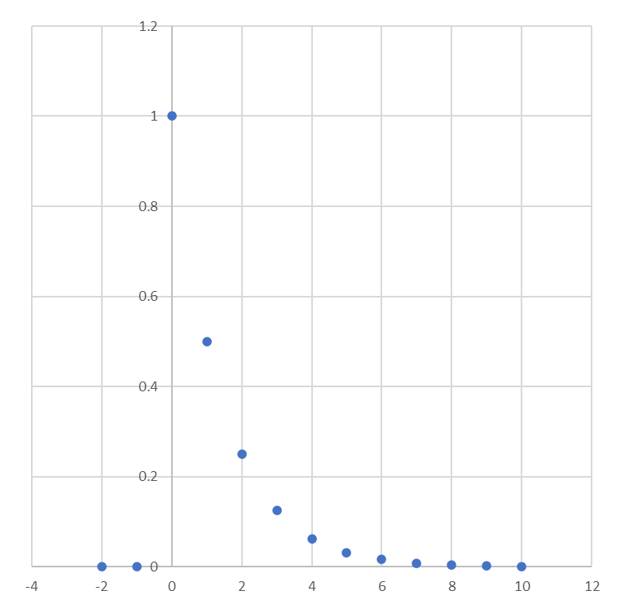




Example:
Impulse response of a discrete-time LTI system is given by h[n]=0.5^{n}u[n]
a) Is this system causal? b) Is this system BIBO stable?
h[n]
a) The system is causal because h[n]=0 for n<0
b)
|0.5|^{k}
=2=C<∞ → system is BIBO stable
|0.5|
n
BLG354E - İTÜ Faculty of Computer Engineering and Informatics - Üstündağ

Slide 11
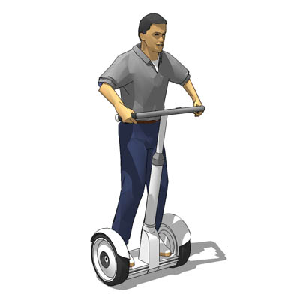
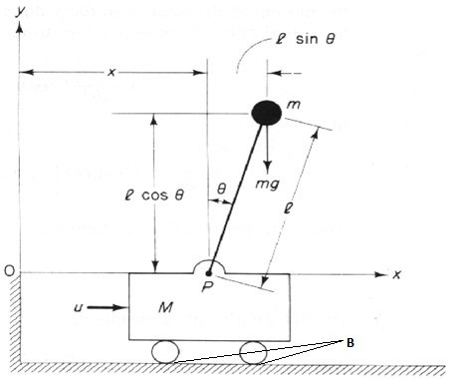
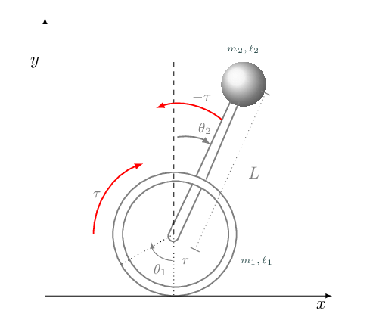
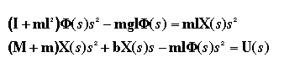
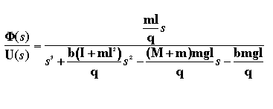
Modelling and Simulation of the Systems
Physical system equation:
Linearization around very small Φ: ϴ=π+ø ,
cos(ϴ) = -1, sin(ϴ) = -ø, and (d(ϴ)/dt)^2 = 0
M | mass of the cart | 0.5 kg
m | mass of the pendulum | 0.5 kg
b | friction of the cart | 0.1 N/m/sec
l | length to pendulum center of mass | 0.3 m
I | inertia of the pendulum | 0.006 kg*m^2
u | step force applied to the cart
x | cart position coordinate
phi | pendulum angle from vertical
Transfer function:
BLG354E - İTÜ Faculty of Computer Engineering and Informatics - Üstündağ

Slide 12
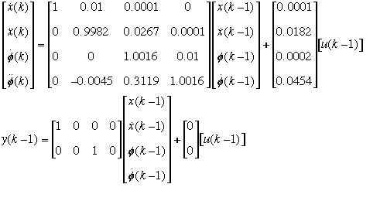
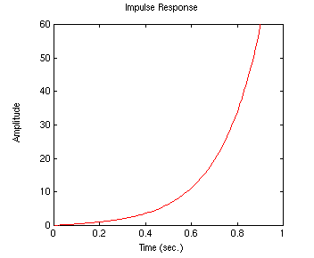
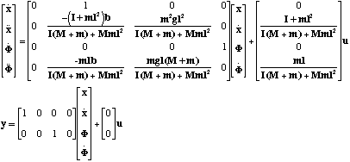
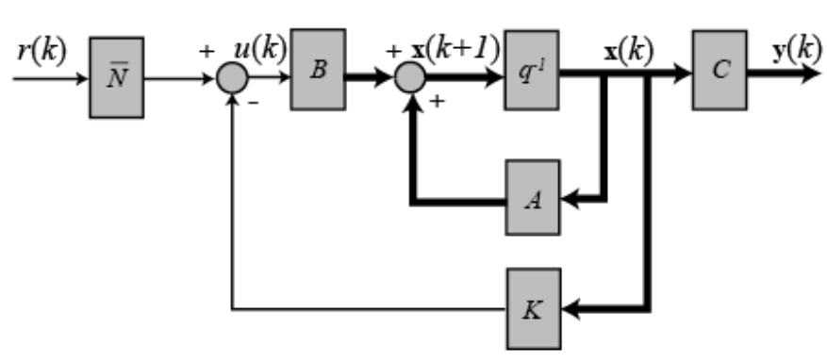
Physical
System
CT System
Model
DT System
Model
Simulation/Control
State space model
BLG354E - İTÜ Faculty of Computer Engineering and Informatics - Üstündağ

Slide 13
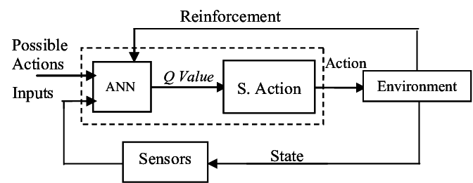
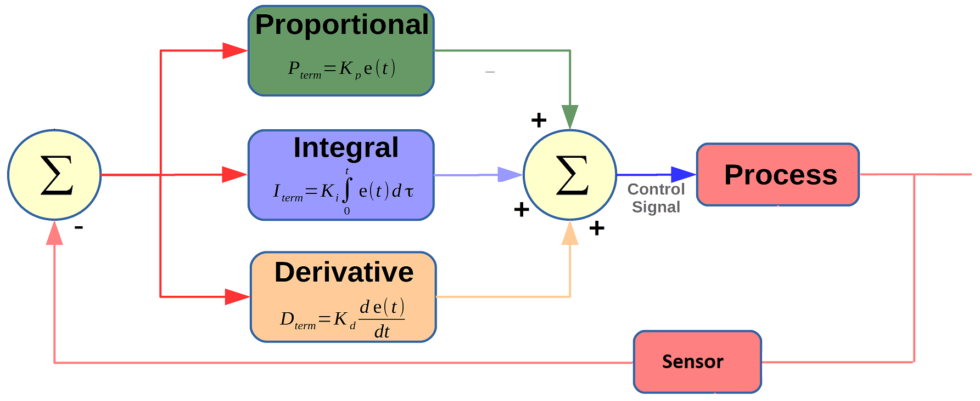
Feedback Control Systems
Actuator
Physical
system
ML Approach to control systems:
Ref
+
Err
Controller
x(t)
System
y(t)
∑
-
Feedback
PID controller example:
PID controller
Noise/Disturbance
Reference
E
Output
+

